Slide 1
Violins for Delta Tests
30/04/2020

Slide 2
First Batch – Parameter Selection by Statistical Averaging

Slide 3
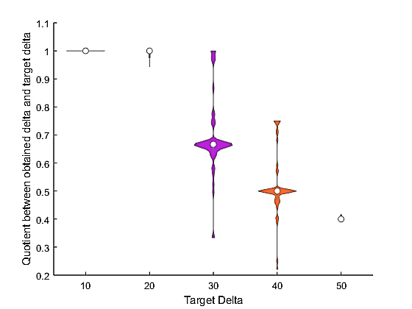
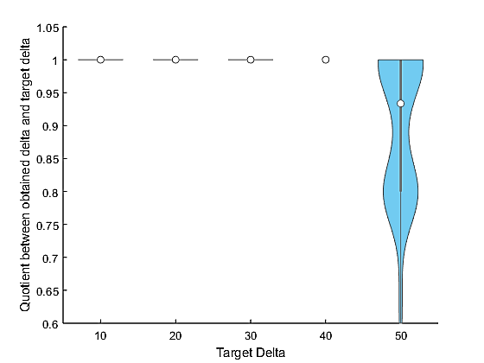
LPTvsALL
ALLvsLPT

Slide 4
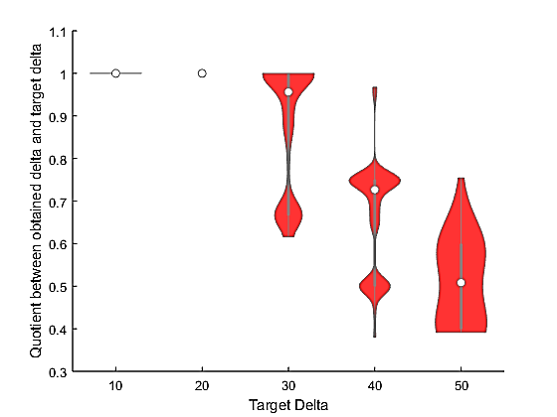
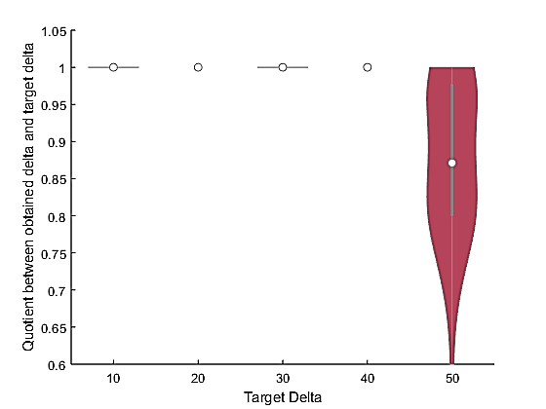
SPTvsALL
ALLvsSPT

Slide 5
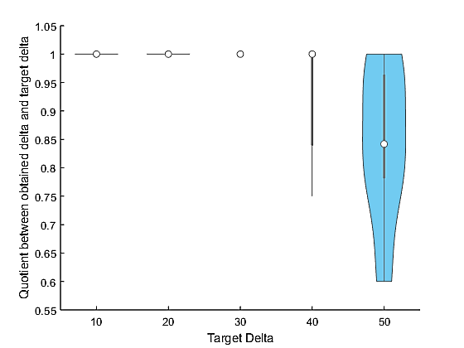
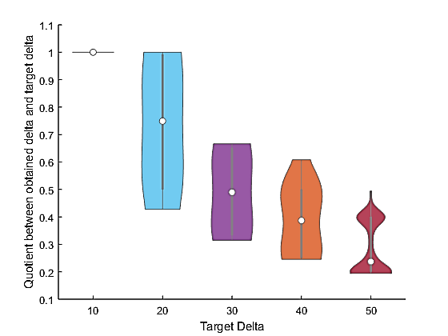
MPAvsALL
ALLvsMPA

Slide 6
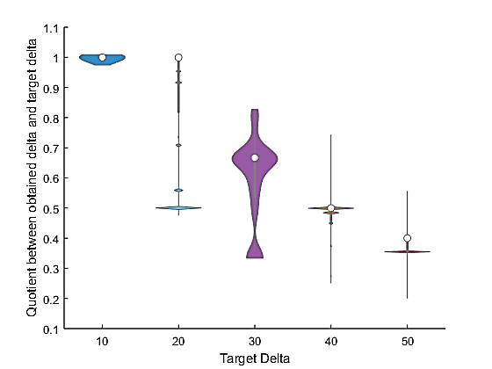
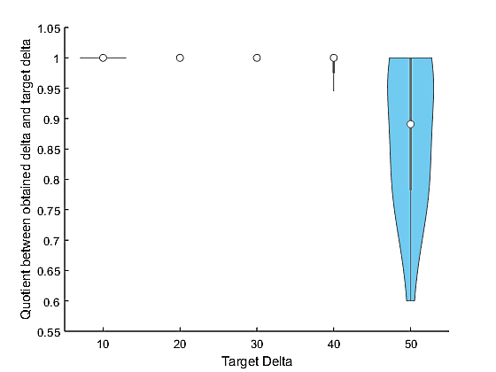
LPAvsALL
ALLvsLPA

Slide 7
Second Batch – Parameter Selection by Ranked Median Values

Slide 8
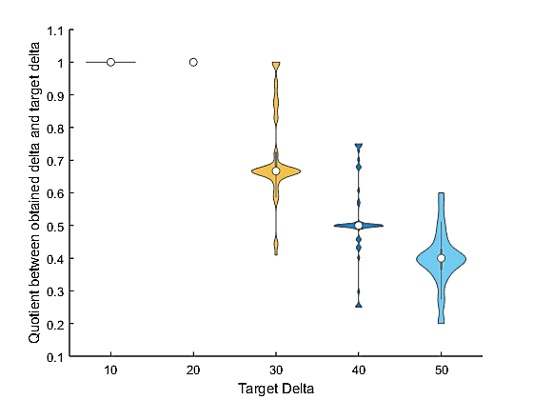
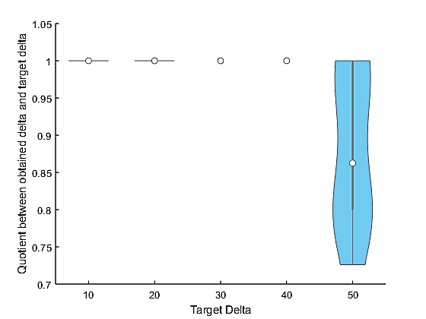
LPTvsALL
ALLvsLPT

Slide 9
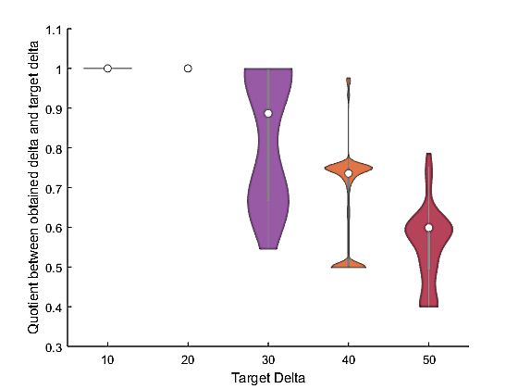
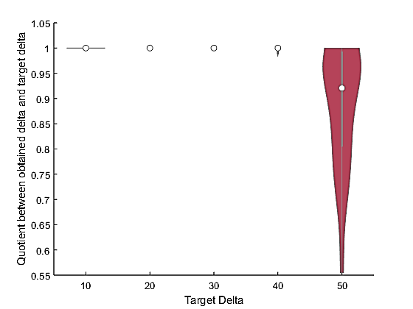
SPTvsALL
ALLvsSPT

Slide 10
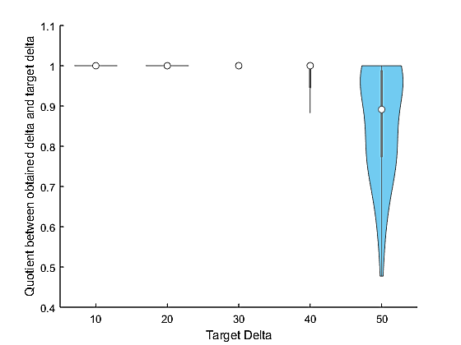
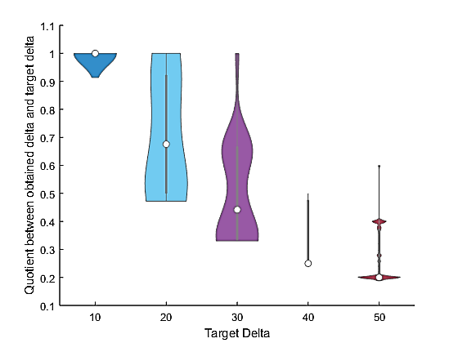
MPAvsALL
ALLvsMPA

Slide 11
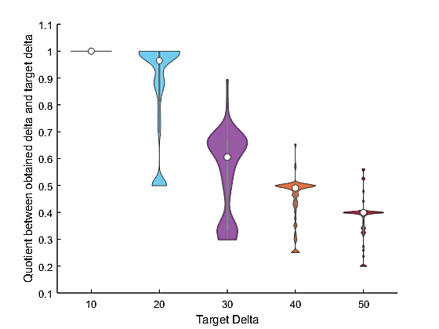
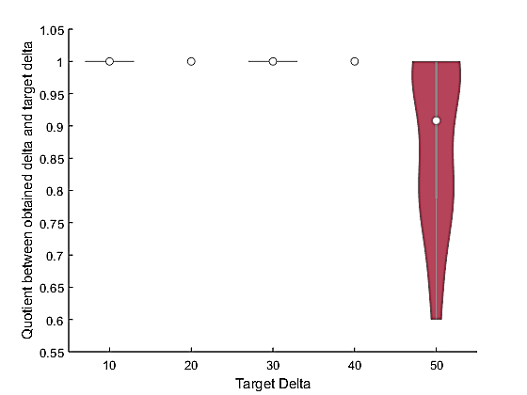
LPAvsALL
ALLvsLPA

Slide 12
Comparison between first and second batch

Slide 13
LPT VS ALL

Slide 14
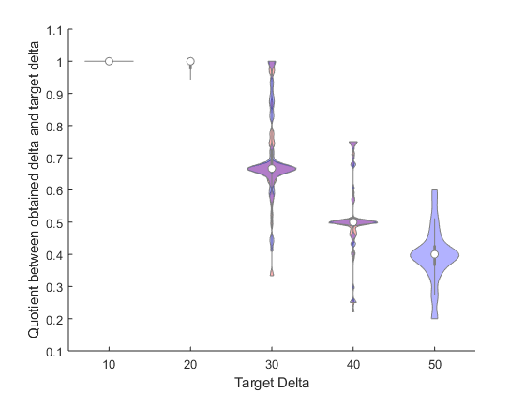
LPT VS ALL

Slide 15
LPT VS ALL

Slide 16
ALL VS LPT

Slide 17
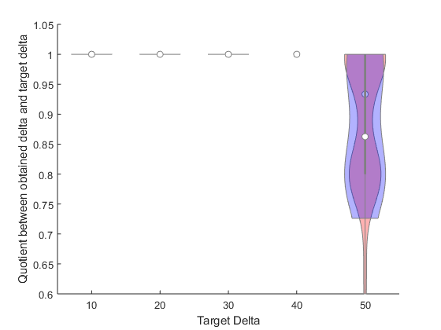
ALL VS LPT

Slide 18
ALL VS LPT

Slide 19
SPT VS ALL

Slide 20
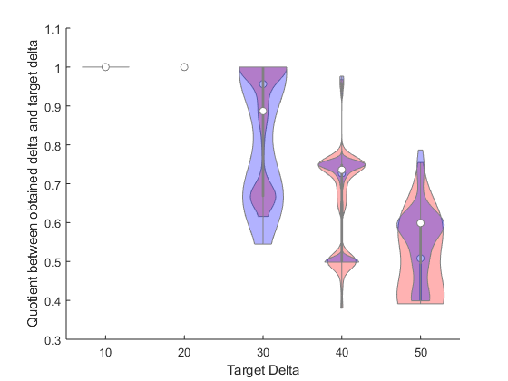
SPT VS ALL

Slide 21
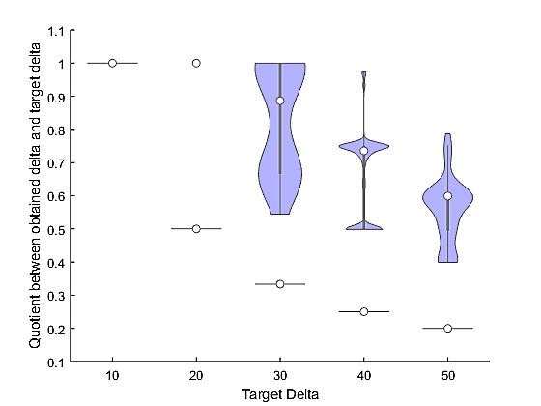
SPT VS ALL

Slide 22
ALL VS SPT

Slide 23
MPA VS ALL

Slide 24
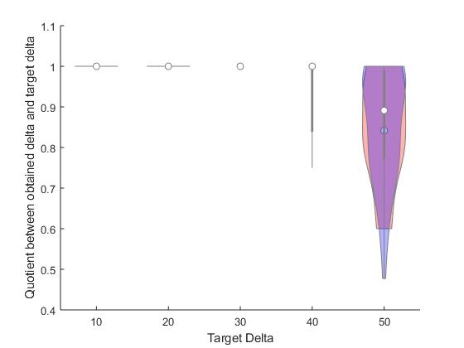
MPA VS ALL

Slide 25
MPA VS ALL

Slide 26
ALL VS MPA

Slide 27
LPA VS ALL

Slide 28
ALL VS LPA

Slide 29
MERGED FIGURES

Slide 30
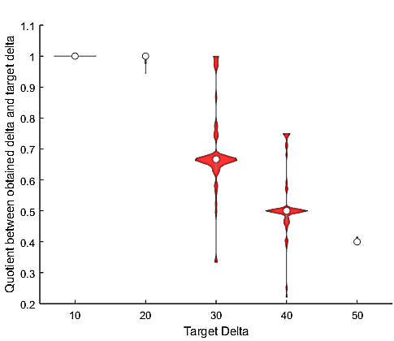
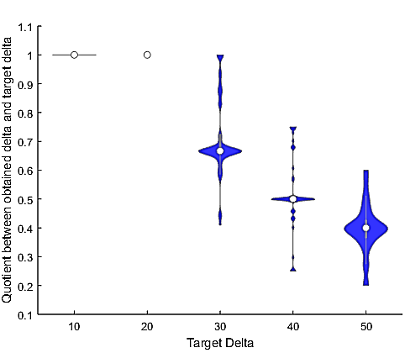
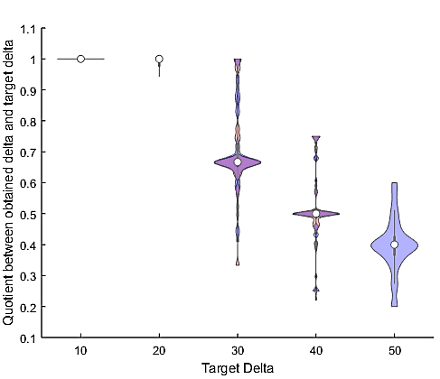
LPTvsAll

Slide 31
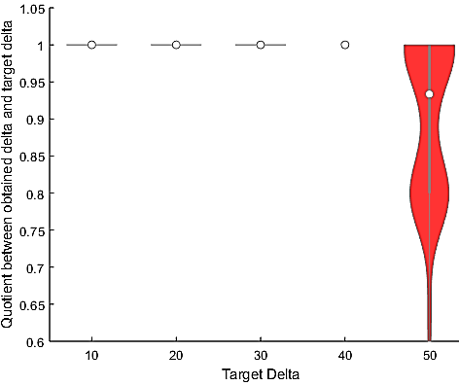
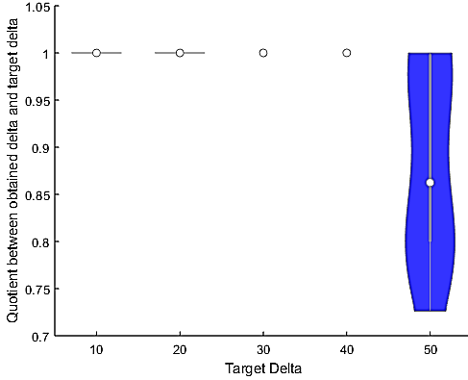
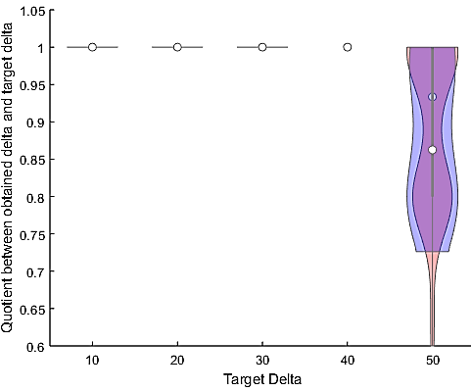
AllvsLPT

Slide 32
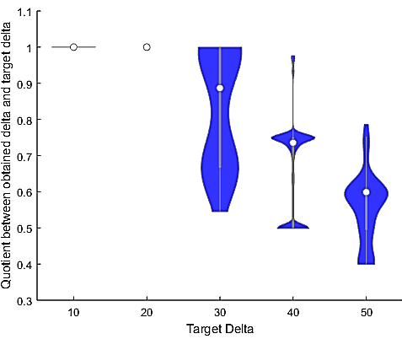
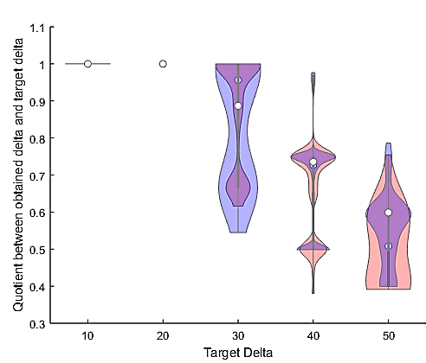
SPTvsAll

Slide 33

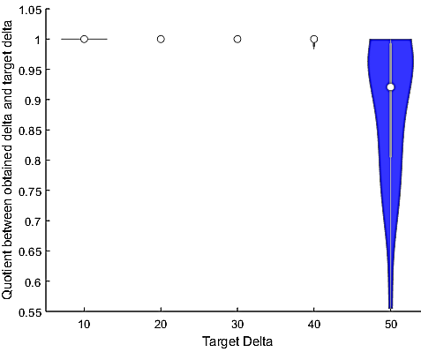
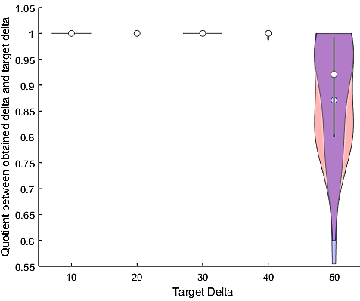
AllvsSPT

Slide 34
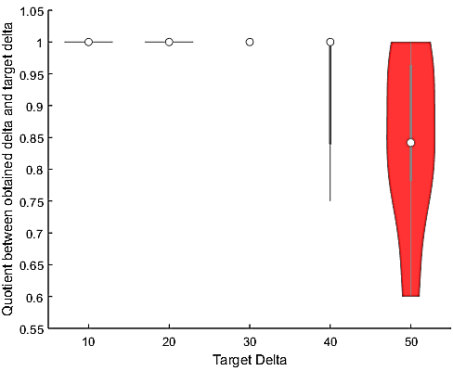
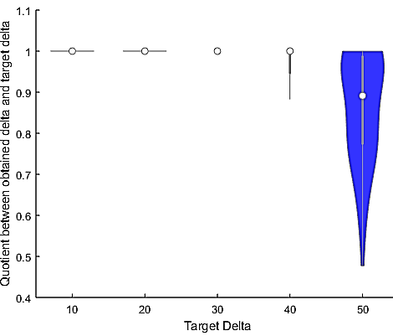
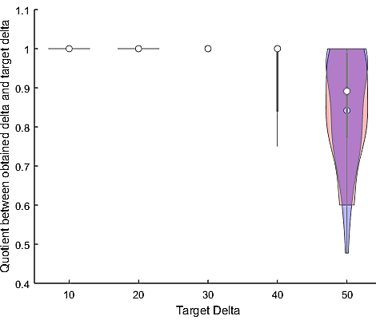
MPAvsAll

Slide 35
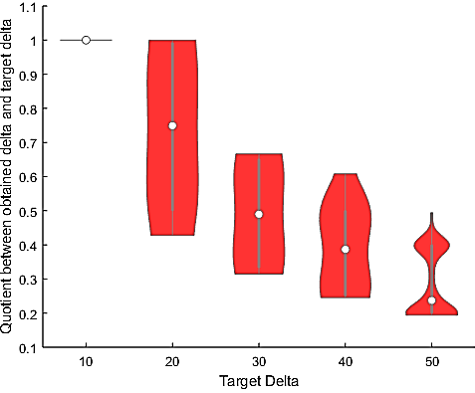
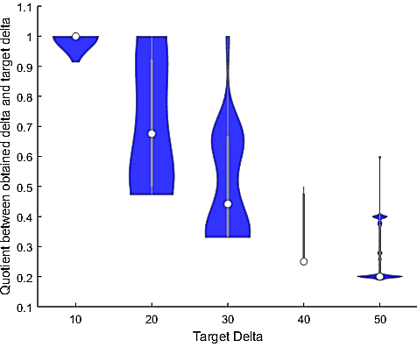
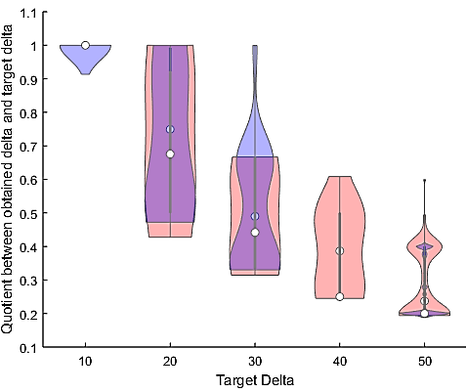
AllvsMPA

Slide 36
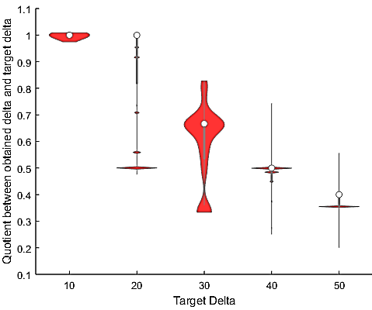
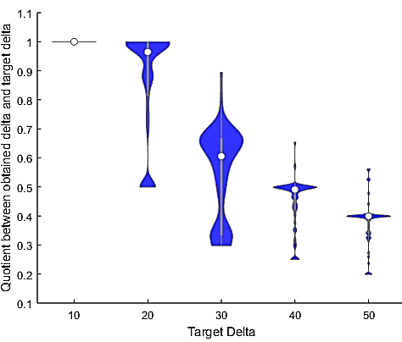
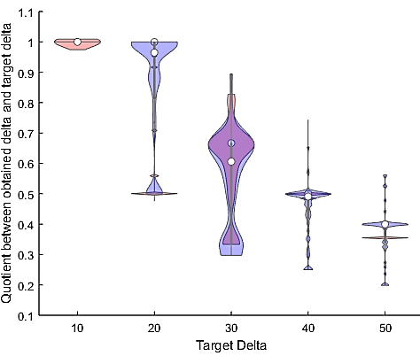
LPAvsAll

Slide 37
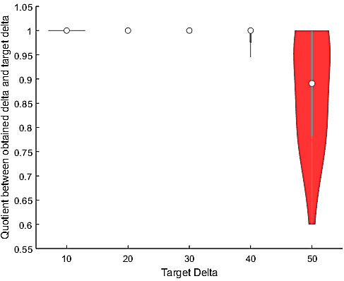
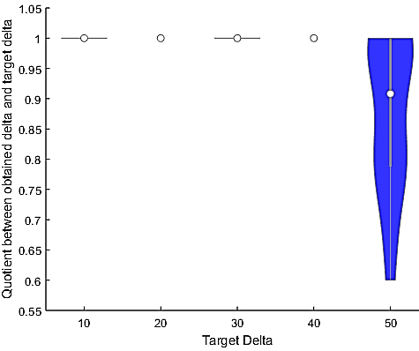
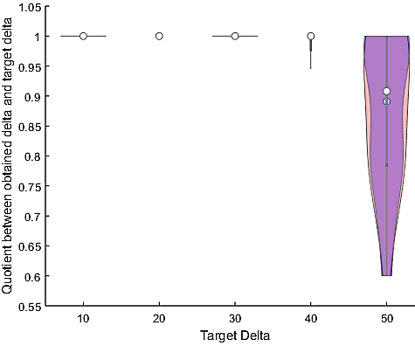
AllvsLPA

